Slide 1
CSDM Interview Case Study
Shiyun(Sharon) Hong

Slide 2
Case 1 - Superman Plus Demand Forecast
Context
Sales Forecasting Method Selection
Observation & Demand Forecast - AMR, Europe, PAC
Further Forecast & Risk Plan

Slide 3
Context
Task - Forecasting the first 15 weeks demand for a new product this year - Superman Plus
Data - Sales historical demand data for last year new product - Princess Plus and the year before - Dwarf Plus.
Dwarf Plus - $120, launched on Sep wk3
Princess Plus - $200, with new tech first time enabled, launched on Oct wk4
Superman Plus - $205, with updated battery &no new tech, launched on Sep wk3

Slide 4
Sales Forecasting Method Selection
1. Qualitative Methods - Used when historical data is lacking
Expert Judgment
Market Research
Analogous Forecasting
2. Time Series Models - Used when historical pattern is stable
Moving Average (MA)
Exponential Smoothing (ES)
Time Series Decomposition
ARIMA (AutoRegressive Integrated Moving Average)
3. Causal Models - Need to identify clear drivers & mass training data
Linear Regression
Machine Learning (XGBoost, Random Forest)

Slide 5
Regional Difference
Price Elasticity:
Princess Plus saw -20% sales impact for 60% price increase vs. Dwarf Plus
AMR: High (-36%)
EU: Moderate (-18%)
PAC: Price resilient (+1%)
Holiday Impact:
AMR: Thanksgiving & Christmas
EU: Christmas
PAC: No major festival between Sep to Dec or possibly evened out
Hence, sales demand for 3 regions need to be forecasted separately

Slide 6
Sales Forecasting Method Selection
Step 1 - Baseline Projection (Launch week)
Adjust Princess Plus launch week data - similar product and lastest year
Regional price elasticity
Updated battery - offset minor price increase
Step 2 - Demand Curve
Apply Dwarf Plus smoothed trend - same launch week
3-step moving average
Percentage decline / increase WoW
Step 3- Adjustment
Holiday factors
Anomaly

Slide 7
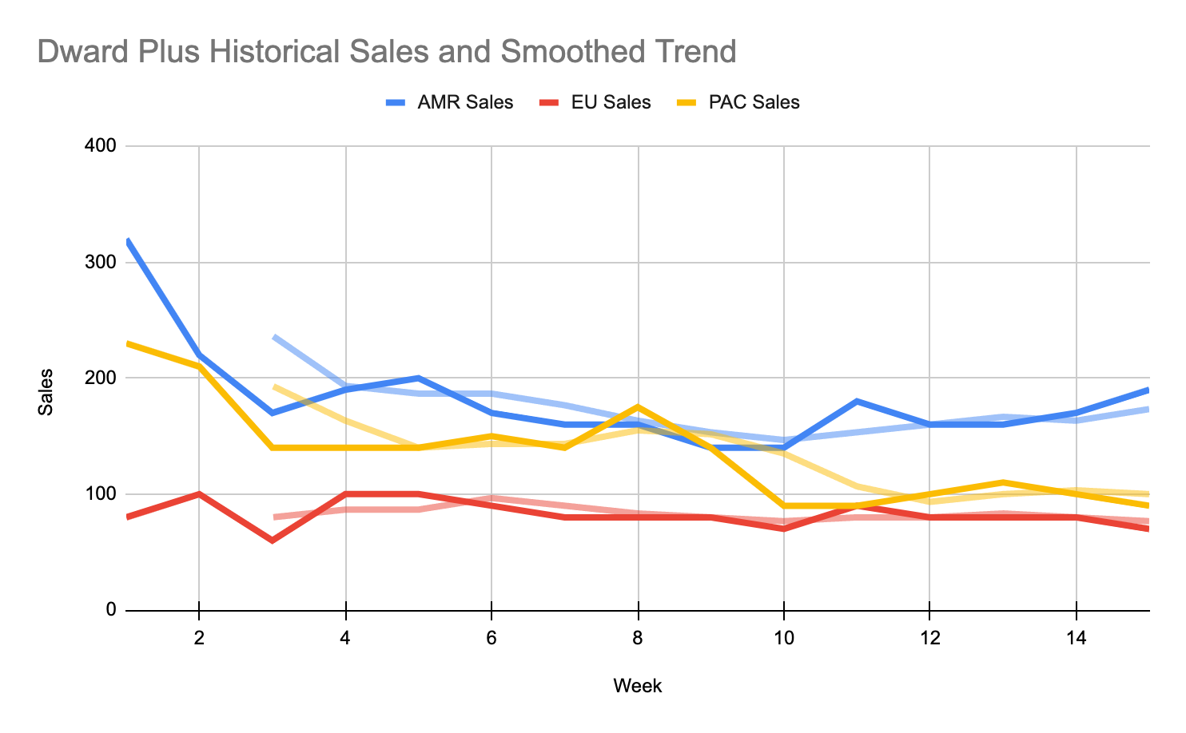

Slide 8
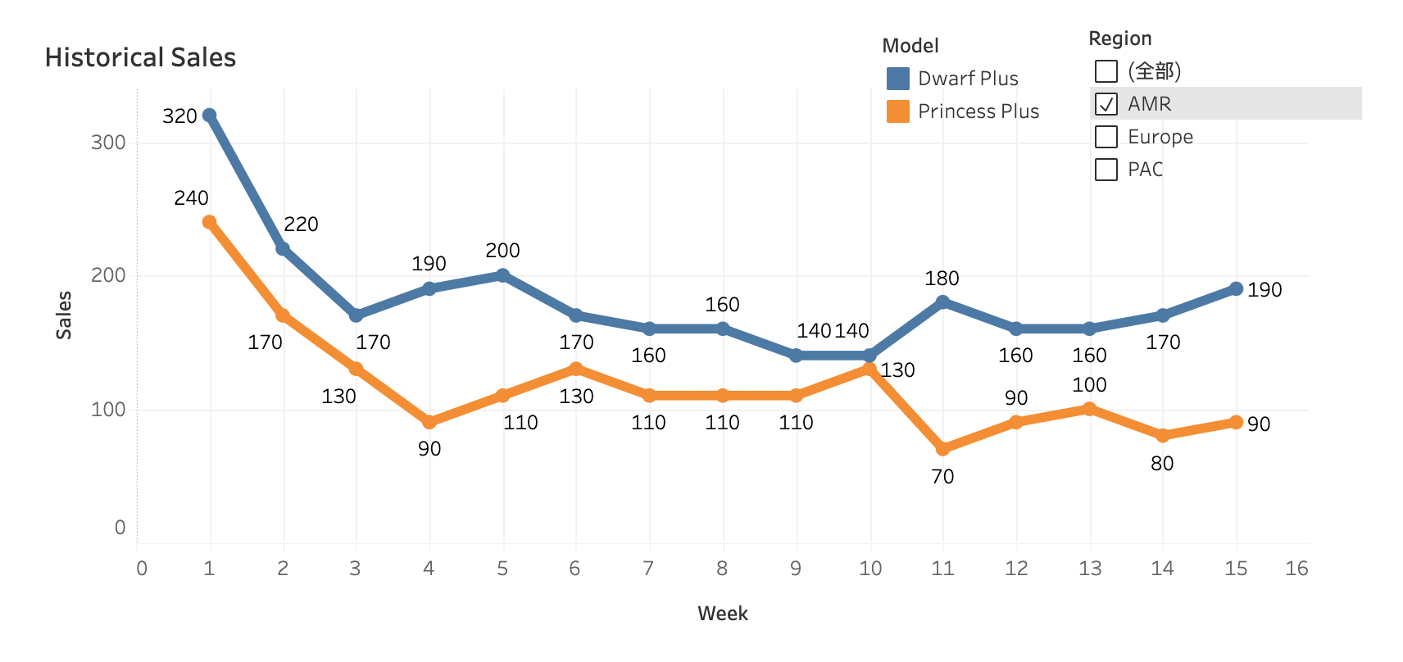
Observations - AMR
1. Strong Price Sensitivity
36% decline in sales on Princess Plus vs. Dwarf Plus
6.7% more revenue ($352K vs. $330K)
36% decline in sales in first week on Princess Plus vs. Dwarf Plus
2. Consistent Launch Pattern
Strong launch, marking the highest in first week
Steeply drop (~30%) after the first week
Followed by a gradual decline, stabilizing after ~8-10 weeks

Slide 9
Observations - AMR
3. Holiday Impact
Thanksgiving & Christmas sales boost
4. January Anomaly
Princess Plus sales dropped 46% in early January - possibly post-holiday spending pullback

Slide 10
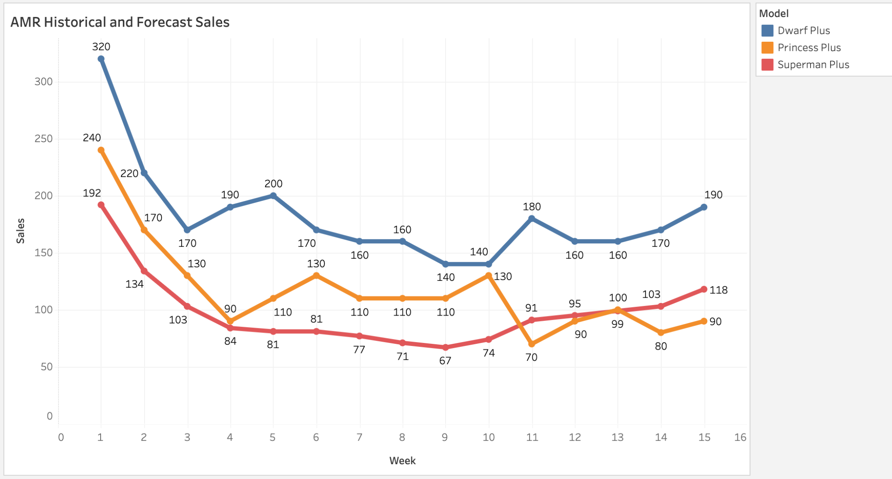
Demand Forecast - AMR
AMR | Total sales | Change%
Superman Plus | 1471 | -16%
Princess Plus | 1760 | -36%
Dwarf Plus | 2730
1. Baseline Projection
Apply 20% reduction vs. Princess Plus launch week - strong price sensitivity & no major tech upgrade
2. Early Week Drop
Expect 25-30% decline in first 2-3 weeks - historical pattern
3. Demand Curve
Follows Dwarf Plus' smoothed trend
4. Adjustments
Uplift for Thanksgiving & Christmas impact

Slide 11
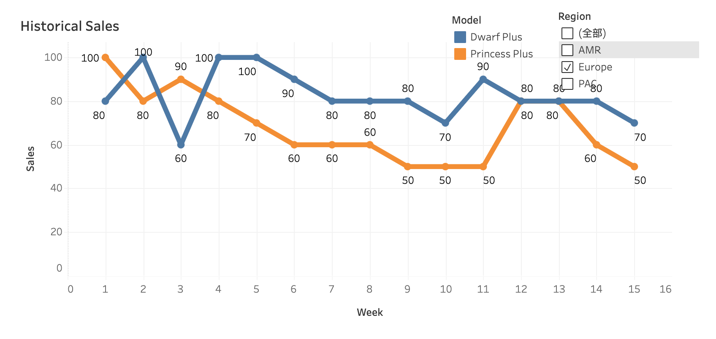
Observations - EU
1. Moderate Price Sensitivity
18% decline in sales on Princess Plus vs. Dwarf Plus
Stable demand over 15 weeks with lower volatility compared to other regions
2. Launch Performance
Strongest sales in launch week
Abnormal fluctuations on Dwarf Plus

Slide 12
Observations - EU
4. Anomaly
Unexpected spikes in Oct wk2 & Nov wk4 on Dwarf Plus
No similar jump on Princess Plus, suggesting short-term campaigns
3. Seasonal Impact
No significant holidays impact

Slide 13
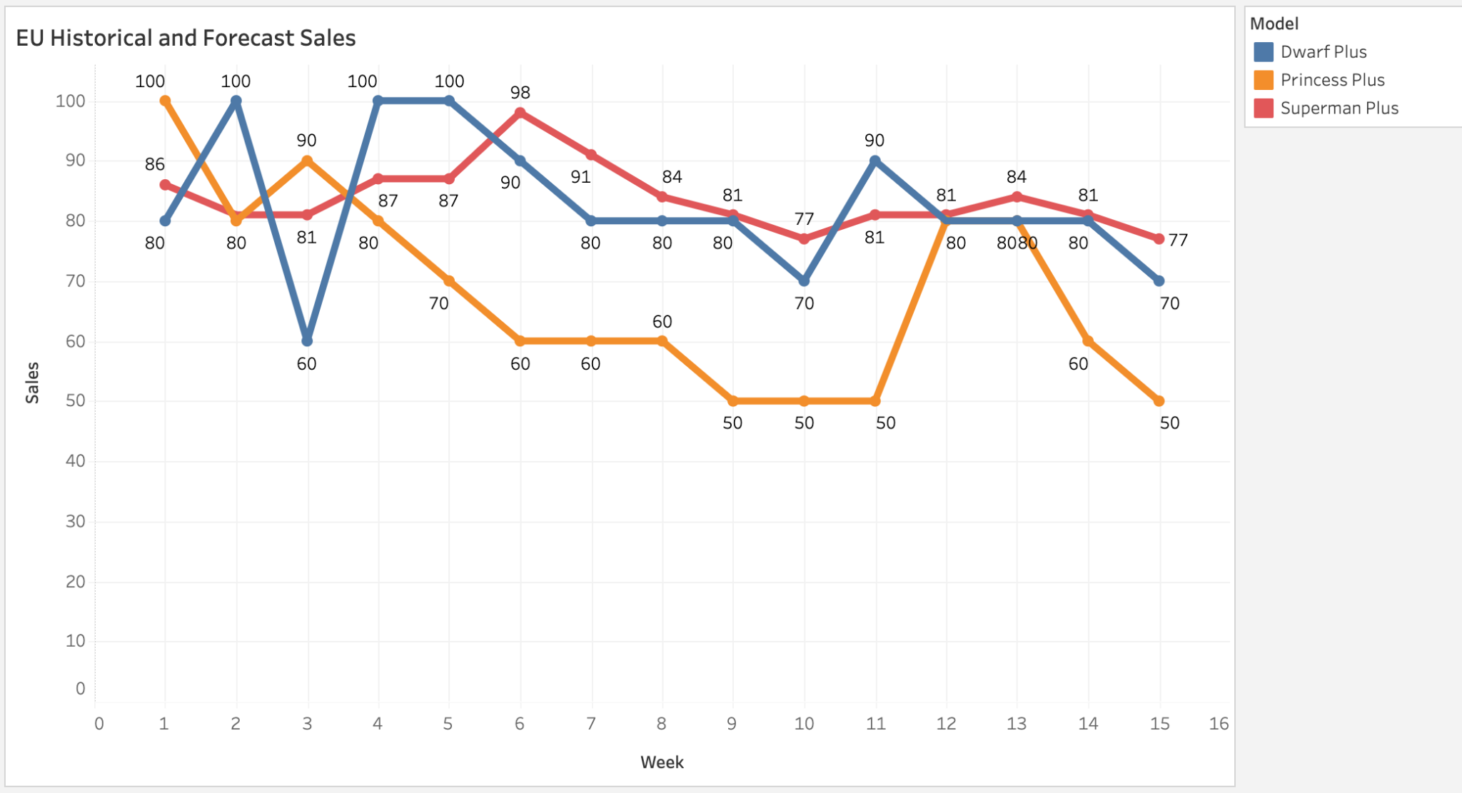
Demand Forecast - EU
Baseline Projection: Apply 5% reduction to average of Princess Plus & Dwarf Plus - high price & no major tech upgrade
Demand Curve: Follow Dwarf Plus’ smoothed trend
Adjustments: No holiday adjustments needed - no significant holidays impact and campaign planned
EU | Total sales | Change%
Superman Plus | 1256 | +23%
Princess Plus | 1020 | -18%
Dwarf Plus | 1240

Slide 14
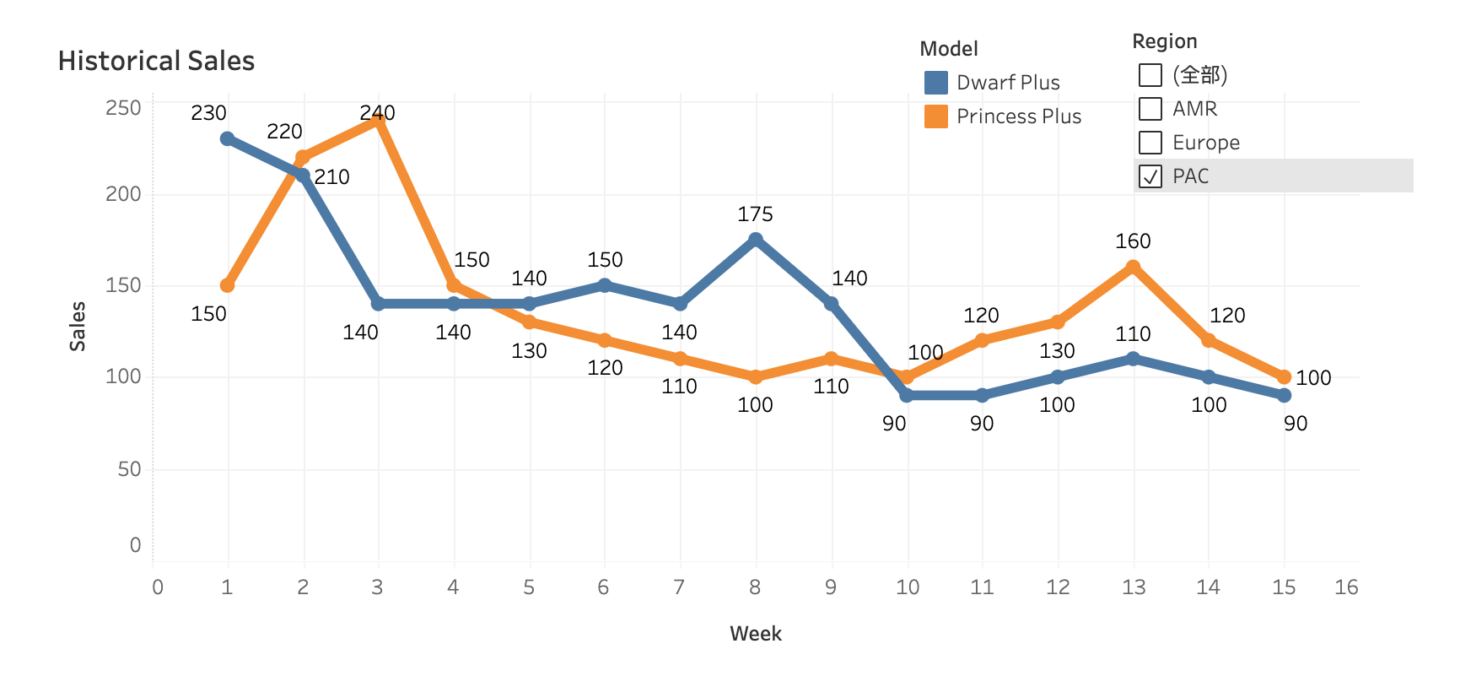
Observations - PAC
1. Low Price Sensitivity
No sales decline (Princess Plus vs. Dwarf Plus)
Consumers show strong brand loyalty and willingness to pay premium pricing
2. Launch Performance:
Princess Plus: Early week growth trend - likely marketing driving
Dwarf Plus: Strong launch, then gradually decline before stabilizing
3. Seasonal Impact:
No major holiday impact or evened out
Stable sales across Sep - Dec

Slide 15
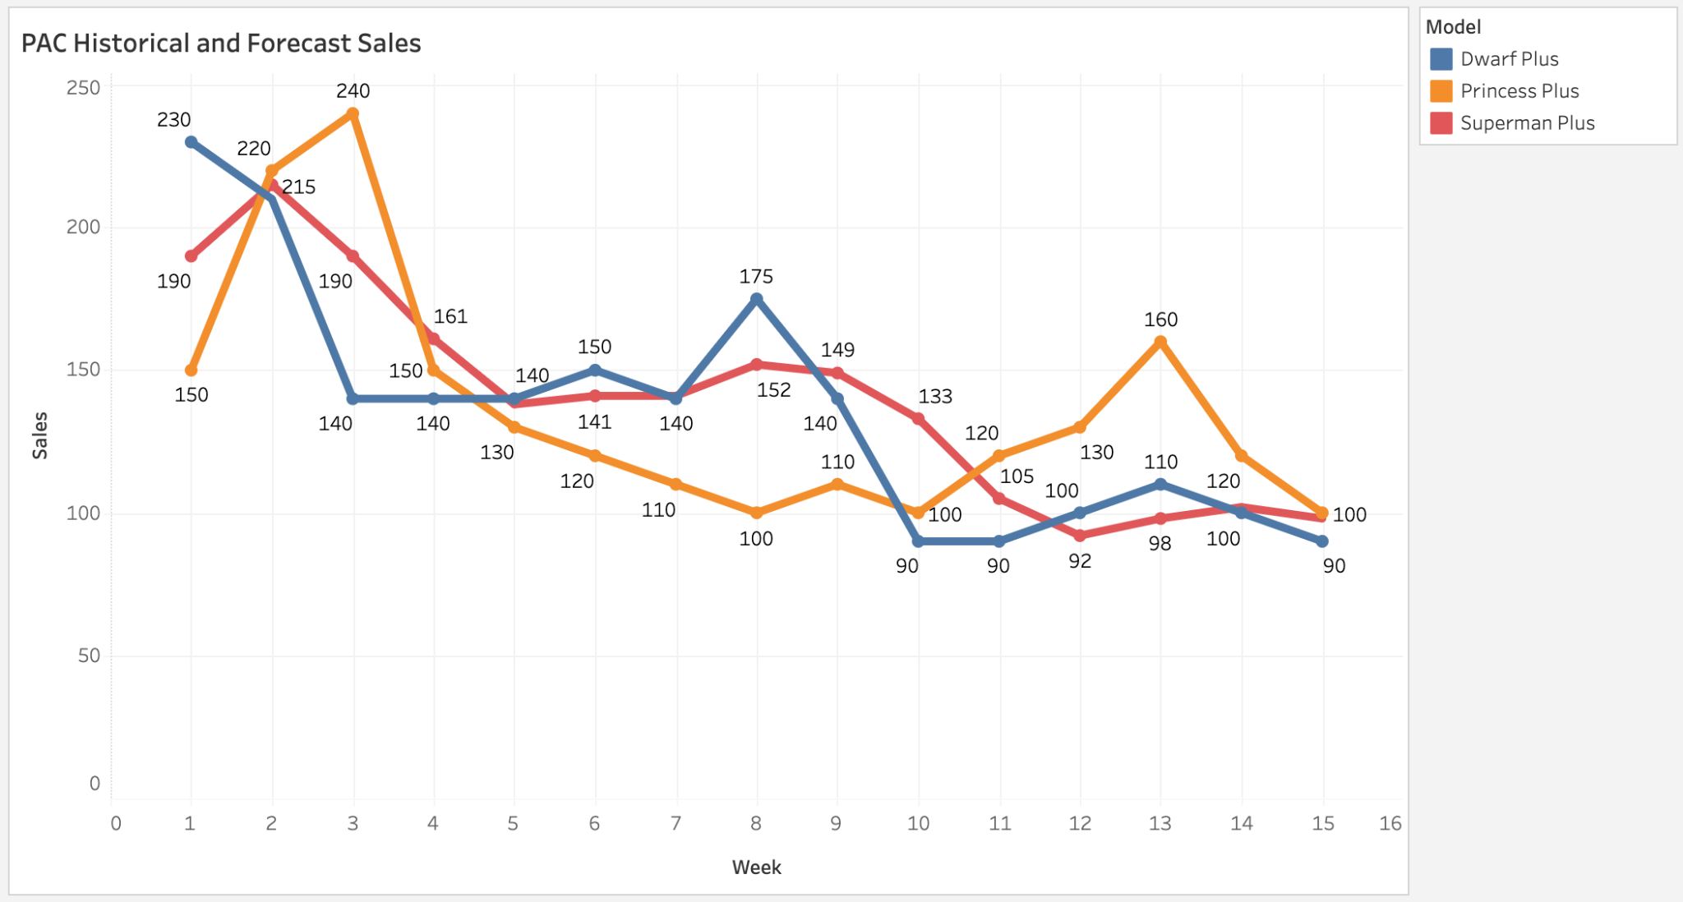
Demand Forecast - PAC
Baseline Projection: Match the average sales of Princess Plus & Dwarf Plus - stable sales in past 2 years
Demand Curve: Apply Dwarf Plus’ smoothed trend
Adjustments: No holiday adjustments needed - consistent year-end demand
EU | Total sales | Change%
Superman Plus | 2104 | 2%
Princess Plus | 2060 | 1%
Dwarf Plus | 2045

Slide 16
Further Forecast & Risk Plan
1. Dynamic Model Refinement
Calibration - Calibrate weekly using actual sales data to improve accuracy
2. Key External Factors
Socioeconomic Factors - Inflation & unemployment impact purchasing power
User Readiness - Are customers still within the usage cycle？
Competitiors - Any major upgrades? Pricing shifts?
Market Signals - Pre-sales & public sentiment guide initial forecasts

Slide 17
Further Forecast & Risk Plan
3. Safety Stock
Hold 10-15% buffer inventory for first week to prevents revenue loss from stockout
4. Risk Plan
When Actual Sales > Forecast:
Increase Production;
Expedite Shipping
When Actual Sales < Forecast:
Promotions/Discounts;
Boost Marketing - target hesitant segments;
Reassess Demand Drivers - economic factors, competitiors

Slide 18
Case 2 - Allocate Superman Plus Supply
Context & Assumptions
Solution under senario A & B
Context
A is the material shared by Superman, Superman Plus and Superman mini
Production of the Superman series is restricted due to the shortage of material A
Task
Allocate remaining Superman Plus supply to each channel, prioritzing Superman & Superman Mini

Slide 19
Assumptions
Each product only need 1 unit of material A
Productivity is not a limitation - factory can build product as long as A is sufficient
100% yield rete
The impact of stockout is identical across all three sales channels

Slide 20
Assumptions
Senario A: Lead time is less than 1 week
Products produced in the current week - Used to fulfill current week's demand
Senario B: Lead time is more than 1 week
Products produced in the current week - Used to fulfill next week's demand

Slide 21
Senario A: Lead time is less than 1 week
Products produced in the current week —— Used to fulfill current week's demand
Demand ask in Jan among 3 channels will be perfectly fullfilled
Demand Ask | Jan Wk2 | Jan Wk3 | Jan Wk4 | Jan Wk5
Superman | 85 | 100 | 110 | 120
Superman Plus | 85 | 120 | 150 | 175
Superman Mini | 40 | 60 | 70 | 75
Total Demand Ask | 210 | 280 | 330 | 370
Total A Supply (Productivity) | 230 | 270 | 320 | 380
Surplus Stock | +20 | +10 | 0 | +10

Slide 22
Senario B: Lead time is more than 1 week
Products produced in the current week — Used to fulfill next week's demand
Jan wk1 built 70 Superman, 70 Superman Plus & 60 Superman Mini
Prioritze Superman & Superman Mini
Without considering the potential shortages from previous week
Demand Ask | Jan Wk2 | Jan Wk3 | Jan Wk4 | Jan Wk5
Superman | 85(-15) | 100 | 110 | 120
Superman Plus | 85(-15) | 120 | 150 | 175
Superman Mini | 40(+20) | 60 | 70 | 75
Total Demand Ask | 210 | 280 | 330 | 370
Total A Supply (Productivity) |  | 230 | 270 | 320
Superman Plus Supply (Productivity) |  | 70 | 90 | 125
Superman Plus Shockout (Not cumulative) | -15 | -50 | -60 | -50

Slide 23
Senario B: Lead time is more than 1 week
Products produced in the current week — Used to fulfill next week's demand
Superman Plus Demand Ask | Jan Wk2 | Jan Wk3 | Jan Wk4 | Jan Wk5
Online Store | 20 | 30 | 40 | 50
Retail Store | 15 | 25 | 30 | 35
Reseller Partners | 50 | 65 | 80 | 90
AMR | 20 | 25 | 30 | 35
Europe | 5 | 10 | 15 | 15
PAC | 25 | 30 | 35 | 40
Total Demand Ask | 85 | 120 | 150 | 175
Superman Plus Supply /Productivity | 70(-15) | 70(-50) | 90(-60) | 125(-50)
How to allocate limited supply to each channel to achieve an optimum?

Slide 24
Senario B: Lead time is more than 1 week
Products produced in the current week — Used to fulfill next week's demand
60 units Superman Mini was built in wk1
Buffer - Jan wk2 Superman Mini - 20 units remain in inventory = Addtional supply
Total Superman Plus supply = Sum of Min Productivity + 20
Superman Plus supply each week must be >= Min Productivity & <= Max Productivity
 | Jan Wk2 | Jan Wk3 | Jan Wk4 | Jan Wk5
Superman Plus Demand Ask | 85 | 120 | 150 | 175
Superman Mini Demand Ask | 40(+20) | 60 | 70 | 75
Superman Plus Min Supply /Productivity |  | 70 | 90 | 125
Superman Plus Max Supply /Productivity |  | 90 | 110 | 145
Addtional Supply |  | x | y | 20 - x - y
If there is no any buffer
If 20 units of A were free

Slide 25
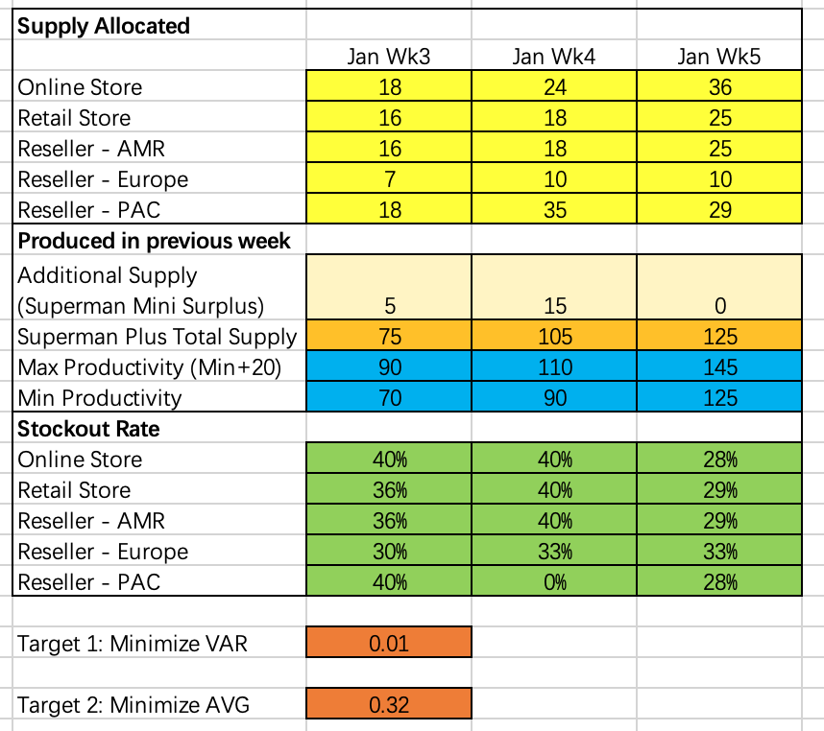
Senario B: Lead time is more than 1 week
Method: Linear programming
Tool: Slover in excel - A tool that optimizes target values by adjusting variable cells under specified constraints.
Variables
x y 20 - x - y
Constraints
Stockout Rate
Objectives

Slide 26
Senario B: Lead time is more than 1 week
Products produced in the current week - Used to fulfill next week's demand
Variables: Supply allocated to each channels
Objectives: Minimize VAR/AVG of Stockout rate
eg. demand ask is 10, supply is 7, Stockout Rate will be 30% = (10-7)/10
Constraints:
PAC Reseller Partner demand ask in Jan wk4 must be fulfilled
Supply allocated must be integer and positive
Superman Plus allocated must be >= Min Productivity & <= Max Productivity
Addtional supply due to Superman Mini surplus = 20
x y 20 - x - y

Slide 27
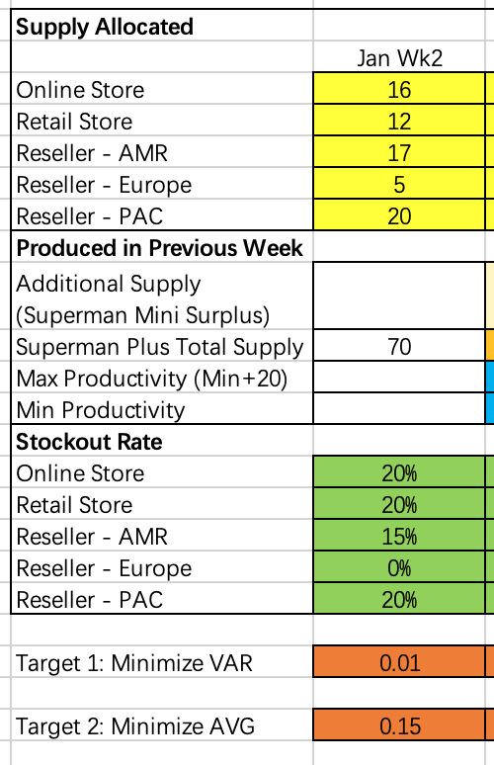
Senario B: Lead time is more than 1 week
Products produced in the current week - Used to fulfill next week's demand
Variables - Supply allocated to each channels
Constraints - Total products built in wk1 is 70
Stockout Rate
Objectives - Minimize VAR/AVG of Stockout rate

Slide 28
Senario B: Objective 1 - Minimize VAR of Stockout Rate
Achieve similar Stockout rates across all channels with minimal variance
VAR = 0.01, AVG = 0.32
5 units of Superman Mini will be allocated on wk3 / wk2 production
15 units will be allocated on wk4 / wk3 production
Actual Supply | Jan Wk2 | Jan Wk3 | Jan Wk4 | Jan Wk5
Online Store | 16 | 18 | 24 | 36
Retail Store | 12 | 16 | 18 | 25
Reseller Partners | 42 | 41 | 63 | 64
AMR | 17 | 16 | 18 | 25
Europe | 5 | 7 | 10 | 10
PAC | 20 | 18 | 35 | 29
Total | 70 | 75 | 105 | 125

Slide 29
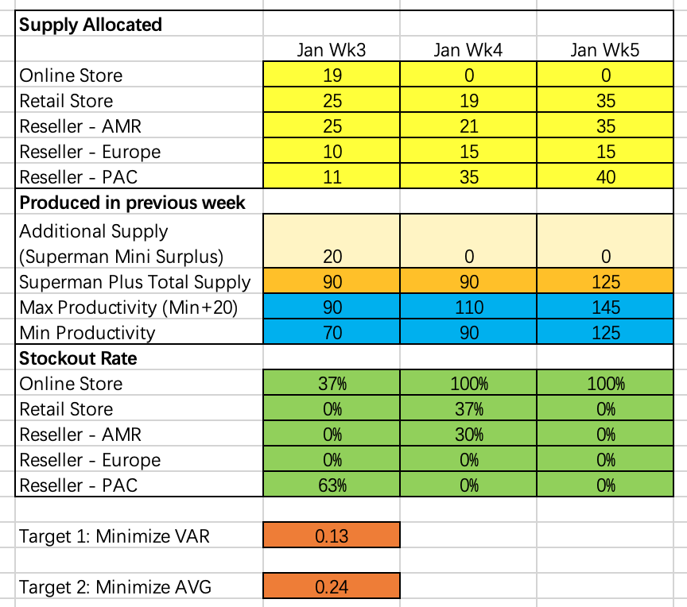
Senario B: Objective 2 - Minimize AVG of Stockout Rate
Minimize overall Stockout rates across all channels
VAR = 0.13, AVG = 0.24
All 20 units of Superman Mini will be allocated on wk3 / wk2 production
Allocate 0 unit to online stores in wk3 and wk4
Actual Supply | Jan Wk2 | Jan Wk3 | Jan Wk4 | Jan Wk5
Online Store | 16 | 19 | 0 | 0
Retail Store | 12 | 25 | 19 | 35
Reseller Partners | 42 | 46 | 71 | 90
AMR | 17 | 25 | 21 | 35
Europe | 5 | 10 | 15 | 15
PAC | 20 | 11 | 35 | 40
Total | 70 | 90 | 90 | 125

Slide 30
Strategy for Managing Stockout
Under the condition that production and shipping efficiency have been maximized:
Online Stores:
Release inventory in batches – Offer limited purchases at fixed times daily to avoid rapid stock depletion
Suggest nearby authorized resellers with availability - Requires real-time inventory synchronization
Retail Stores:
Appointment-based purchasing - Manage walk-in demand
Shift inventory - Allocate a higher quantity of inventory to high-demand retail locations
Personalized suggestion - Recommend alternative available models based on customer preferences
Reseller Partners:
Prevent bulk buying - Enforce purchase limits per customer.
Enhance stock visibility - Require real-time inventory synchronization with central system

